Slide 1
SYLLABUS OF SEMESTER -I,
M.C.A. (MASTER IN COMPUTER APPLICATION)
Course Code: MCT543
Course: Concepts in Software Engineering
L:3 Hrs., T:0 Hrs., P: 0 Hrs.,Per week
Total Credits: 3

Slide 2
Course Objectives
To enable the development of skills through which the student will gain expertise to engineer software of high quality by following sound analysis and design principles.
Learn to plan and execute the project effectively through requirements analysis, estimation, risk management and project scheduling activities.
To develop various project management techniques for managing real world projects and object oriented approach towards software engineering.
To inculcate quality consciousness in students through effective testing strategies and software quality management.

Slide 3
Course Outcomes
On successful completion of the course students will be able to:
Develop skills to engineer software of high quality by following sound analysis and design principles.
Learn successful project execution strategies like requirements analysis, estimation, risk management and project scheduling activities.
Use various project management techniques for managing real world projects and to develop an object oriented approach towards software engineering.
Inculcate quality consciousness through effective software quality management.

Slide 4
Syllabus
Section -I (Weightage – 20%, Minimum Theory Teaching Hours-7)
Introduction to Software Engineering:
Software engineering paradigms, Generic view of software engineering, Software metrics, Measures and metrics, Scheduling, Metrics of software quality.

Slide 5
Section -II (Weightage – 50%, Minimum Theory Teaching Hours -15 )
Software Project Management: Software project estimation and planning, Decomposition techniques, Risk Management, Requirement analysis.
Object Oriented Analysis: Object oriented analysis and data modeling, Object oriented concepts, Class Based Modeling.
Agile Development: About Agility, Agility and cost of change, Agile process, Agile process models (Adaptive software development, Scrum, Dynamic system development method), Agile Software development Approaches
Software Design Engineering: The design process and fundamentals, Effective modular Design, Data flow oriented design, Transform analysis, Transaction analysis, Design heuristics.

Slide 6
Section -III ( Weightage – 30% , Minimum Theory Teaching Hours -8 )
Software Quality Management:
Software quality assurance, Software testing techniques, S/W testing fundamentals, White box testing, Black box testing, Validation testing, System testing, Debugging, software maintenance: maintainability, Maintenance tasks, Reverse engineering and reengineering.

Slide 7
Text Books:
Software Engineering : Roger S. Pressman, TMH
Software Engineering For Students : D.Bell, AddisonWisley,
Reference Books:
Fundamentals of Software Engineering: Ghezzi, Jazayeri&Mandrioli, PHI.
Software Engineering concept: Richard Fairley, Tata McGraw Hill.
Fundamental of Software Engineering,:Mall, PHI.

Slide 8
SOFTWARE
Software is
Instructions (computer programs) that when executed provide desired function and performance
Data structures that enable the programs to adequately manipulate information
Documents that describe the operation and use of the programs.

Slide 9
Software Characteristics
Software is a logical rather than a physical system element.
Therefore, software has characteristics that are considerably different than those of hardware:
Software is developed or engineered, it is not manufactured in the classical sense.
In both activities (development and manufacturing), high quality is achieved through good design, but the manufacturing phase for hardware can introduce quality problems that are nonexistent (or easily corrected) for software.
Both activities are dependent on people, but the relationship between people applied and work accomplished is entirely different.
Both activities require the construction of a "product" but the approaches are different. Software costs are concentrated in engineering.
This means that software projects cannot be managed as if they were manufacturing projects.

Slide 10
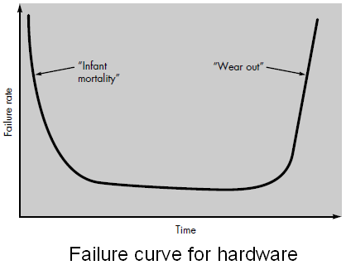
2. Software doesn't "wear out."
Figure shows failure rate as a function of time for hardware.
The relationship, often called the “bathtub curve”, indicates that hardware exhibits relatively high failure rates early in its life; defects are corrected and the failure rate drops to a steady-state level (ideally, quite low) for some period of time.
As time passes, however, the failure rate rises again as hardware components suffer from the cumulative affects of dust, vibration, abuse, temperature extremes, and many other environmental maladies.
Stated simply, the hardware begins to wear out.

Slide 11
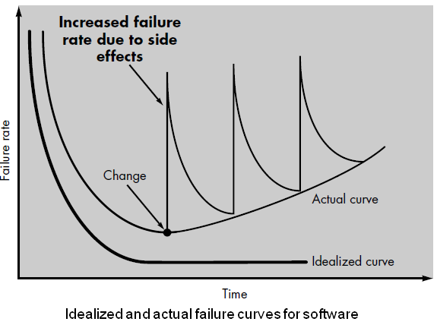
When a hardware component wears out, it is replaced by a spare part. There are no software spare parts. Every software failure indicates an error in design or in the process through which design was translated into machine executable code. Therefore, software maintenance involves considerably more complexity than hardware maintenance.

Slide 12
3. Although the industry is moving toward component-based assembly, most software continues to be custom built.
The design engineer draws a simple schematic of the digital circuitry, does some fundamental analysis to assure that proper function will be achieved, and then goes to the shelf where catalogs of digital components exist. Each integrated circuit (called an IC or a chip) has a part number, a defined and validated function, a well-defined interface, and a standard set of integration guidelines. After each component is selected, it can be ordered off the shelf.

Slide 13
The reusable components have been created so that the engineer can concentrate on the truly innovative elements of a design, that is, the parts of the design that represent something new.
In the hardware world, component reuse is a natural part of the engineering process.
In the software world, it is something that has only begun to be achieved on a broad scale.
A software component should be designed and implemented so that it can be reused in many different programs.
Today, we have extended our view of reuse to encompass not only algorithms but also data structure.
Modern reusable components encapsulate both data and the processing applied to the data, enabling the software engineer to create new applications from reusable parts.
For example, today's graphical user interfaces are built using reusable components that enable the creation of graphics windows, pull-down menus, and a wide variety of interaction mechanisms.
The data structure and processing detail required to build the interface are contained with a library of reusable components for interface construction.

Slide 14
The changing nature of Software
Seven broad categories of computer software present continuing challenges for software engineers:
System software
Application software
Engineering and scientific software
Embedded software
Product-line software
Web-Applications
Artificial intelligence software

Slide 15
The changing nature of Software
1. System software.
System software is a collection of programs written to service other programs.
Some system software (e.g., compilers, editors, and file management utilities) processes complex, but determinate, information structures.
Other systems applications (e.g., operating system components, drivers, telecommunications processors) process largely indeterminate data.

Slide 16
The changing nature of Software
2. Application software.
Stand-alone programs that solve a specific business need.
Applications in this area process business or technical data in a way that facilitates business operations or management/technical decision making.
In addition to conventional data processing applications, application software is used to control business functions in real time (e.g., point-of-sale transaction processing, real-time manufacturing process control).

Slide 17
The changing nature of Software
3. Engineering and scientific software.
Has been characterized by “number crunching” algorithms.
Applications range from astronomy to volcanology, from automotive stress analysis to space shuttle orbital dynamics, and from molecular biology to automated manufacturing.
However, modern applications within the engineering/scientific area are moving away from conventional numerical algorithms.
Computer-aided design, system simulation, and other interactive applications have begun to take on real-time and even system software characteristics.

Slide 18
The changing nature of Software
4. Embedded software.
Resides within a product or system and is used to implement and control features and functions for the end user and for the system itself.
Embedded software can perform limited and esoteric functions (e.g., key pad control for a microwave oven) or provide significant function and control capability (e.g., digital functions in an automobile such as fuel control, dashboard displays, and braking systems).

Slide 19
The changing nature of Software
5. Product-line software.
Designed to provide a specific capability for use by many different customers.
Product-line software can focus on a limited and esoteric(private, heavy) marketplace (e.g., inventory control products) or address mass consumer markets (e.g., word processing, spreadsheets, computer graphics, multimedia, entertainment, database management, and personal and business financial applications).

Slide 20
The changing nature of Software
6. Web-Applications.
Called “WebApps,” this network-centric software category spans a wide array of applications.
In their simplest form, WebApps can be little more than a set of linked hypertext files that present information using text and limited graphics.
However, as Web 2.0 emerges, WebApps are evolving into sophisticated computing environments that not only provide stand-alone features, computing functions, and content to the end user, but also are integrated with corporate databases and business applications.

Slide 21
The changing nature of Software
7. Artificial intelligence software.
Makes use of non numerical algorithms to solve complex problems that are not responsible to computation or straightforward analysis.
Applications within this area include robotics, expert systems, pattern recognition (image and voice), artificial neural networks, theorem proving, and game playing.

Slide 22
Generic View of Software Engineering
What exactly is a software process from a technical point of view?
A software process is a framework for the activities, actions and tasks that are required to build high-quality software.
Is “process” synonymous with software engineering?
The answer is “yes and no.”
A software process defines the approach that is taken as software is engineered.
But software engineering also consists technologies that populate the process—technical methods and automated tools.
Software engineering is performed by creative, knowledgeable people who should adapt a mature software process so that it is appropriate for the products that they build and the demands of their marketplace.

Slide 23
Software Engineering – Layered Technology
A definition proposed by Fritz Bauer [NAU69] at the seminal conference on the subject still serves as a basis for discussion:
Software engineering is the establishment and use of sound engineering principles in order to obtain economically software that is reliable and works efficiently on real machines.
The IEEE [IEE93] has developed a more comprehensive definition when it states:
Software Engineering: (1) The application of a systematic, disciplined, quantifiable(computable) approach to the development, operation, and maintenance of software; that is, the application of engineering to software. (2) The study of approaches as in (1).

Slide 24
FIGURE 2.1 Software engineering layers
Layered Technology
Tools: CASE preferred
Methods: technical “how to’s”
Process model: the “framework”
A quality focus: the “bedrock”

Slide 25
A quality Focus
Every organization is rest on its commitment to quality.
Total quality management, Six Sigma, or similar continuous improvement culture and it is this culture ultimately leads to development of increasingly more effective approaches to software engineering.
The bedrock that supports software engineering is a quality focus.

Slide 26
Process
It’s a glue which holds all layers together.
It defines a framework for a set of key process areas (KPA) for effectively manage and deliver quality software in a cost effective manner.
The KPAs form the basis for management control of software projects and establish the context in which technical methods are applied, work products (models, documents, data, reports, forms, etc.) are produced, milestones are established, quality is ensured, and change is properly managed.
The processes define the tasks to be performed and the order in which they are to be performed

Slide 27
Methods
It provides the technical how-to's for building software.
Methods encompass a broad array of tasks that include requirements analysis, design, program construction, testing, and support.
There could be more than one technique to perform a task and different techniques could be used in different situations.
Software engineering methods rely on a set of basic principles that govern each area of the technology and include modeling activities and other descriptive techniques.

Slide 28
Tools
Provide automated or semi-automated support for the process, methods and quality control.
When tools are integrated so that information created by one tool can be used by another, a system for the support of software development, called computer-aided software engineering (CASE)
CASE combines software, hardware, and a software engineering database to create a software engineering environment analogous to CAD/CAE (computer-aided design/engineering) for hardware.

Slide 29
Process Framework
A process is a collection of activities, actions, and tasks that are performed when some work product is to be created.
An activity strives to achieve a broad objective (e.g., communication with stakeholders) and is applied regardless of the application domain, size of the project, complexity of the effort, or degree of rigor with which software engineering is to be applied.
An action encompasses a set of tasks that produce a major work product (e.g., an architectural design model).
A task focuses on a small, but well-defined objective (e.g., conducting a unit test) that produces an outcome.

Slide 30
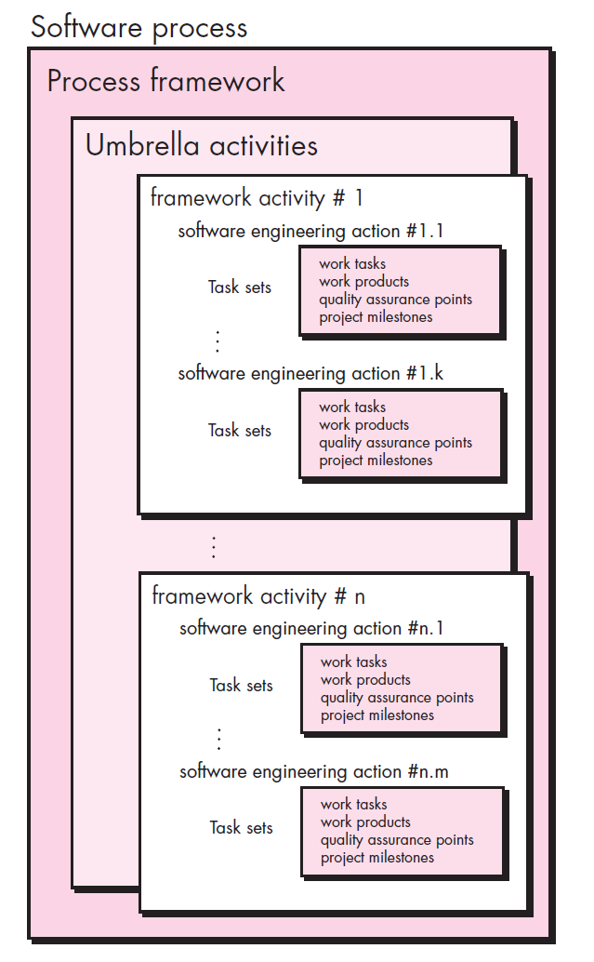
A Software Process Framework
Each framework activities is populated by a set for software engineering actions – a collection of related tasks. Each software engineering action is defined by a task set
that identifies the work tasks that are to be completed,
the work products that will be produced,
the quality assurance points that will be required, and the milestones that will be used to indicate progress.

Slide 31
Generic Process Framework Activities
A generic process framework for software engineering encompasses five activities:
Communication: Before any technical work can commence, it is critically important
to communicate and collaborate with the customer and other stakeholders.
to understand stakeholders’ objectives for the project
to gather requirements that help define software features and functions.
Planning: A software project plan—defines
the software engineering work by describing the technical tasks to be conducted,
the risks that are likely,
the resources that will be required,
the work products to be produced,
a work schedule.

Slide 32
Generic Process Framework Activities
Modeling: A software engineer creates models
to better understand software requirements and
the design that will achieve those requirements
The modeling activity is composed of two software engg. actions – Analysis and Design .
Analysis encompasses a set of work tasks (e.g. requirements gathering, elaboration, negotiation, specification, and validation.)that lead to the creation of the analysis model(and /or requirement specification )
Design encompasses work tasks (data design, architectural design and component level design) that create design model.
Construction:
Code generation: either manual or automated or both
Testing – to uncover error in the code.
Deployment:
Delivery to the customer for evaluation
Customer provides feedback
NOTE: These five generic framework activities can be used during the development of small, simple programs, the creation of large Web applications, and for the engineering of large, complex computer-based systems. The details of the software process will be quite different in each case, but the framework activities remain the same.

Slide 33
Umbrella Activities
Software engineering process framework activities are complemented by a number of umbrella activities. In general, umbrella activities are applied throughout a software project and help a software team manage and control progress, quality, change, and risk.
Typical umbrella activities include
Software project tracking and control
Assessing progress against the project plan.
Take adequate action to maintain schedule.
Formal technical reviews
Assessing software work products in an effort to uncover and remove errors before goes into next action or activity.
Software quality assurance
Define and conducts the activities required to ensure software quality.

Slide 34
Umbrella Activities
Software configuration management
Manages the effects of change.
Document preparation and production
Help to create work products such as models, documents, logs, form and list.
Reusability management
Define criteria for work product reuse
Mechanisms to achieve reusable components.
Measurement
Define and collects process, project, and product measures
Assist the team in delivering software that meets customer’s needs.
Risk management
Assesses risks that may effect that outcome of project or quality of product (i.e. software)

Slide 35
Capability Maturity Model (CMM)
The Software Engineering Institute (SEI) has developed a model predicated on a set of software engineering capabilities for organizations which reach different levels of process maturity.
To determine an organization’s current state of process maturity, the SEI uses an assessment that results in a five point grading scheme.
The grading scheme determines compliance with a capability maturity model (CMM) that defines key activities required at different levels of process maturity.
The SEI approach provides a measure of the global effectiveness of a company's software engineering practices and establishes five process maturity levels that are defined in the following manner:

Slide 36
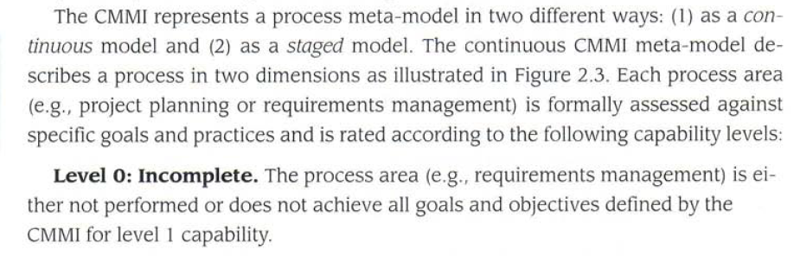
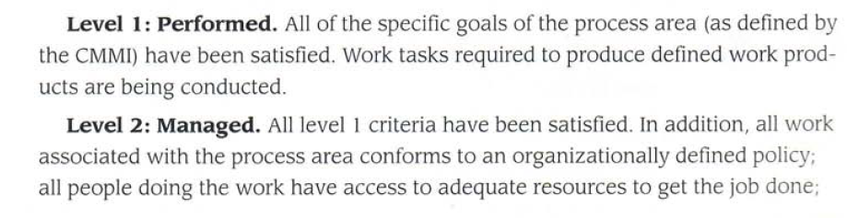

Slide 37
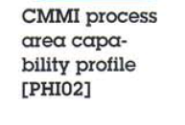
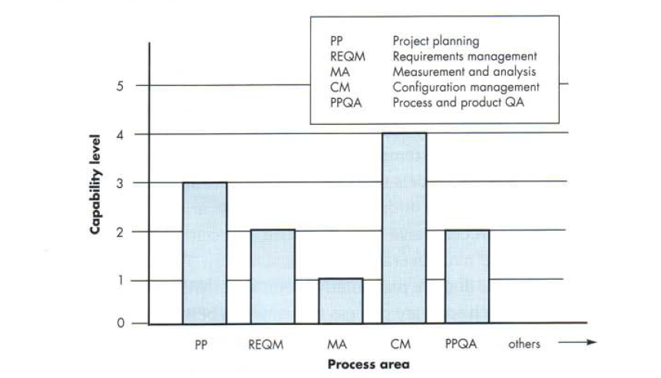

Slide 38
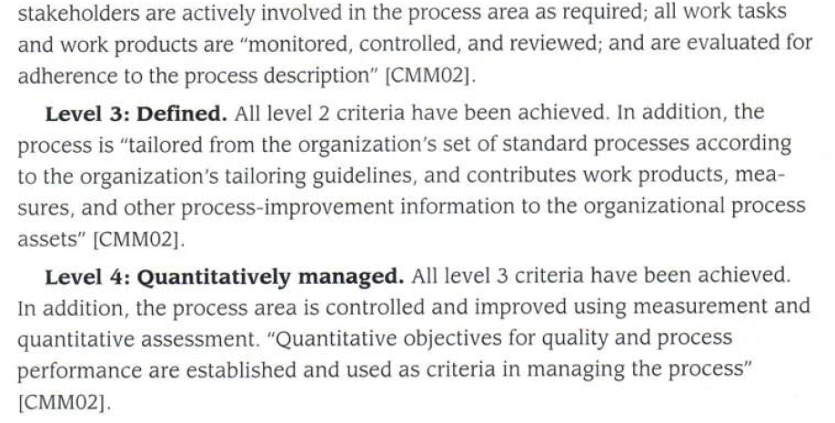
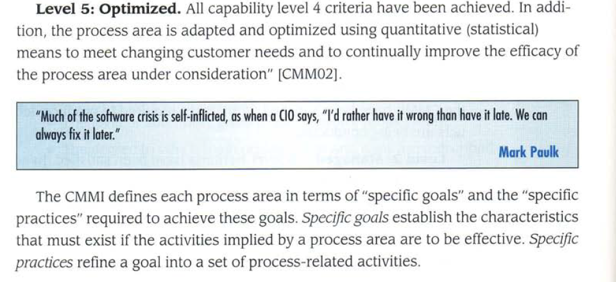

Slide 39
SOFTWARE PROCESS MODELS Prescriptive Process Model
Defines a distinct set of activities, actions, tasks, milestones, and work products that are required to engineer high-quality software
The activities may be linear, incremental, or evolutionary
Waterfall Model –represents elements of a linear process flow
Incremental Model – combines elements of linear and parallel process flows
Evolutionary Model – follows the evolutionary process flow that combines elements of linear and iterative process flows
Prototyping
Spiral
Concurrent Model – combines elements of iterative and parallel process flows

Slide 40
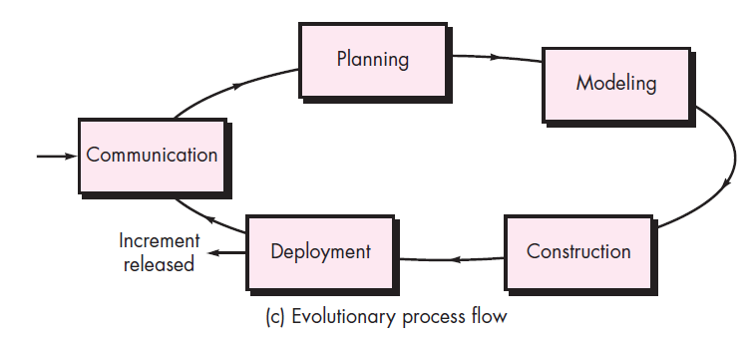
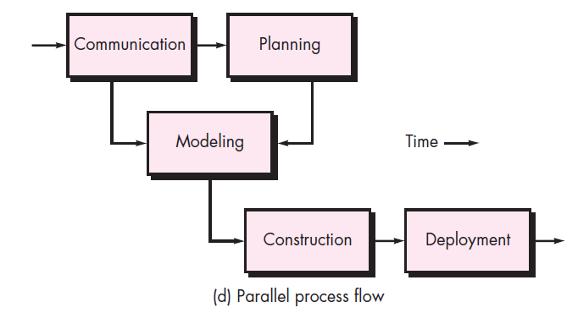
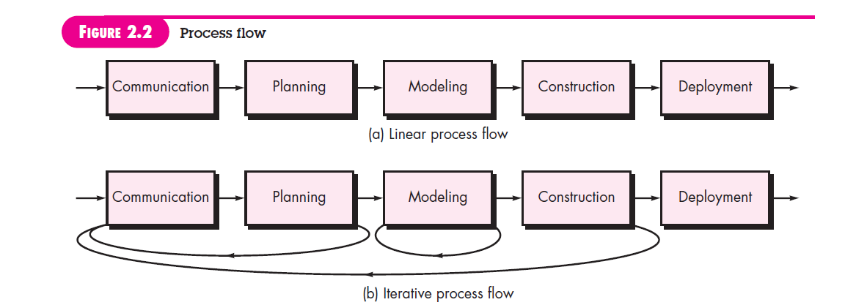
Process Flows

Slide 41
The Waterfall Model
The waterfall model is the oldest paradigm for software engineering.
There are times when the requirements for a problem are well understood—when work flows from communication through deployment in a reasonably linear fashion.
This situation is sometimes encountered when well-defined adaptations or enhancements to an existing system must be made (e.g., an adaptation to accounting software that has been mandated because of changes to government regulations).
It may also occur in a limited number of new development efforts, but only when requirements are well defined and reasonably stable.
The waterfall model, sometimes called the classic life cycle.

Slide 42
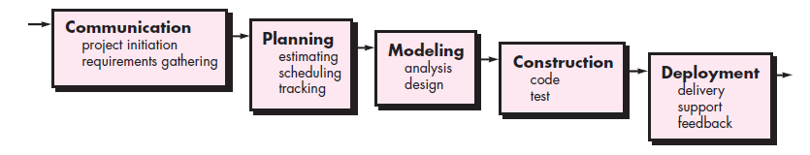
The Waterfall Model
It is a systematic, sequential approach to software development. That is, when the first phase is finished then only the second phase will start and so on.
It begins with customer specification of requirements.
It progresses through planning, modeling, construction, and deployment.
At the end of a phase, a review take place to determine if the project is on the right path and whether or not to continue or discard the project.
In this testing starts only after the development is completed and phases do not overlap.

Slide 43
The Waterfall Model
Problems that are sometimes encountered when the waterfall model is applied are:
1. Real projects rarely follow the sequential flow that the model proposes.
Although the linear model can accommodate iteration, it does so indirectly.
As a result, changes can cause confusion as the project team proceeds.
2. It is often difficult for the customer to state all requirements explicitly.
The waterfall model requires this and has difficulty accommodating the natural uncertainty that exists at the beginning of many projects.
3. The customer must have patience.
A working version of the program(s) will not be available until late in the project time span.
A major blunder, if undetected until the working program is reviewed, can be disastrous.

Slide 44
Advantages | Disadvantages
Simple and easy to understand | Difficult to go back and change something
Easy to manage | No working software until late stages of SDLC
Phases don’t overlap | Risk and Uncertainty
Best for small projects | Not suitable for complex and object oriented projects
Sets requirement stability. | All requirements must be known upfront
Good for management control. | Integration is one big bang at the end
Works well when quality is more important than cost or schedule. | Little opportunity for customer to preview the system.
Provides structure to inexperienced staff.
Milestones are well understood.

Slide 45
Incremental Process Models
There are many situations in which initial software requirements are reasonably well defined, but the overall scope of the development effort prevents a purely linear process.
In addition, there may be a compelling(impressive) need to provide a limited set of software functionality to users quickly and then refine and expand on that functionality in later software releases.
In such cases, you can choose a process model that is designed to produce the software in increments.
THE INCREMENTAL MODEL
THE RAD MODEL

Slide 46
The Incremental Model
The incremental model combines elements of linear and parallel process flows.
Incremental model applies linear sequences in a staggered fashion as calendar time progresses.
Each linear sequence produces deliverable “increments” of the software in a manner that is similar to the increments produced by an evolutionary process flow.
For example, word-processing software developed using the incremental paradigm might deliver basic file management, editing, and document production functions in the first increment; more sophisticated editing and document production capabilities in the second increment; spelling and grammar checking in the third increment; and advanced page layout capability in the fourth increment.

Slide 47
The Incremental Model
It should be noted that the process flow for any increment can incorporate the prototyping paradigm.
When an incremental model is used, the first increment is often a core product.
That is, basic requirements are addressed but many supplementary features (some known, others unknown) remain undelivered.
The core product is used by the customer (or undergoes detailed evaluation).
As a result of use and/or evaluation, a plan is developed for the next increment.
The plan addresses the modification of the core product to better meet the needs of the customer and the delivery of additional features and functionality.
This process is repeated following the delivery of each increment, until the complete product is produced.

Slide 48
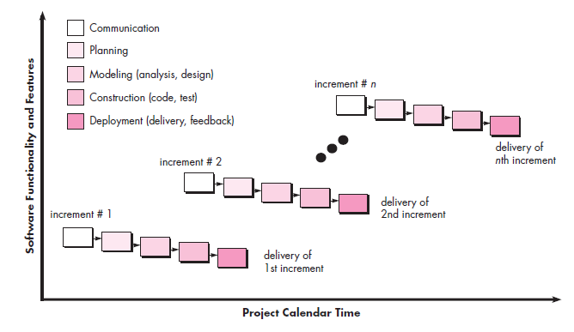
The Incremental Model

Slide 49
The Incremental Model
It focuses on the delivery of an operational product with each increment.
Early increments are stripped-down versions of the final product, but they do provide capability that serves the user and also provide a platform for evaluation by the user.
Incremental development is particularly useful when staffing is unavailable for a complete implementation by the business deadline that has been established for the project.
Early increments can be implemented with fewer people. If the core product is well received, then additional staff (if required) can be added to implement the next increment.
In addition, increments can be planned to manage technical risks. For example, a major system might require the availability of new hardware that is under development and whose delivery date is uncertain.
It might be possible to plan early increments in a way that avoids the use of this hardware, thereby enabling partial functionality to be delivered to end users without inordinate delay.

Slide 50
The Incremental Model
Advantages
Generates working software quickly and early during the software life cycle.
This model is more flexible – less costly to change scope and requirements.
It is easier to test and debug during a smaller iteration.
In this model customer can respond to each built.
Lowers initial delivery cost.
Easier to manage risk because risky pieces are identified and handled during it’d iteration.
Disadvantages
Needs good planning and design.
Needs a clear and complete definition of the whole system before it can be broken down and built incrementally.
Total cost is higher than waterfall.

Slide 51
Advantages | Disadvantages
Some working functionality can be developed quickly and early in the life cycle. Results are obtained early and periodically. Parallel development can be planned. Progress can be measured. Less costly to change the scope/requirements. Testing and debugging during smaller iteration is easy. Risks are identified and resolved during iteration; and each iteration is an easily managed milestone. Easier to manage risk - High risk part is done first. With every increment operational product is delivered. Issues, challenges & risks identified from each increment can be utilized/applied to the next increment. Risk analysis is better. It supports changing requirements. Initial Operating time is less. Better suited for large and mission-critical projects. During life cycle software is produced early which facilitates customer evaluation and feedback. | More resources may be required. Although cost of change is lesser but it is not very suitable for changing requirements. More management attention is required. System architecture or design issues may arise because not all requirements are gathered in the beginning of the entire life cycle. Defining increments may require definition of the complete system. Not suitable for smaller projects. Management complexity is more. End of project may not be known which is a risk. Highly skilled resources are required for risk analysis. Projects progress is highly dependent upon the risk analysis phase.

Slide 52
THE RAD MODEL
Rapid application development (RAD) is an incremental software development process model that emphasizes an extremely short development cycle.
The RAD model is a “high-speed” adaptation of the linear sequential model in which rapid development is achieved by using component-based construction.
If requirements are well understood and project scope is constrained, the RAD process enables a development team to create a “fully functional system” within very short time periods (e.g., 60 to 90 days).
Like other process models , the RAD Approach maps into the generic framework activities.
Communication works to understand the business problem and the information characteristics that the software must accommodate.
Planning is essential because multiple software teams work in parallel on different system functions.

Slide 53
THE RAD MODEL
Modeling encompasses three major phases
Business modeling
Data modeling
Process modeling
And establishes design representations that serve as the basis for RADS construction activity.
Construction emphasizes the use of pre-existing software components and the application of automatic code generation
Finally deployment establishes a basis for subsequent iterations , if required.
Obviously, the time constraints imposed on a RAD project demand “scalable scope”.
If a business application can be modularized in a way that enables each major function to be completed in less than three months, it is a candidate for RAD.
Each major function can be addressed by a separate RAD team and then integrated to form a whole.

Slide 54
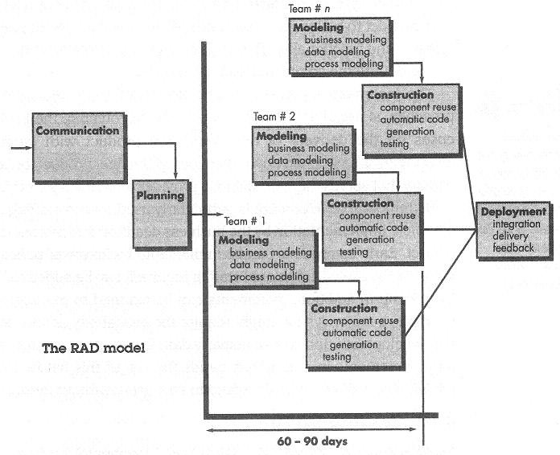
THE RAD MODEL

Slide 55
THE RAD MODEL
Like all process models, the RAD approach has drawbacks:
For large but scalable projects
RAD requires sufficient human resources to create the right number of RAD teams.
If developers and customers are not committed to the rapid-fire activities necessary to complete the system in a much abbreviated time frame, RAD projects will fail.
3. If a system cannot be properly modularized, building the components necessary for RAD will be problematic.
4. If high performance is an issue and performance is to be achieved through tuning the interfaces to system components, the RAD approach may not work.
5.RAD is not appropriate when technical risks are high(When a new application makes heavy use of new technology)

Slide 56
THE RAD MODEL
Advantages | Disadvantages
Changing requirements can be accommodated. Progress can be measured. Iteration time can be short with use of powerful RAD tools. Productivity with fewer people in short time. Reduced development time. Increases reusability of components Quick initial reviews occur Encourages customer feedback Integration from very beginning solves a lot of integration issues. | Dependency on technically strong team members for identifying business requirements. Only system that can be modularized (changeable, portable)can be built using RAD. Requires highly skilled developers/designers. High dependency on modeling skills. Inapplicable to cheaper projects as cost of modeling and automated code generation is very high. Management complexity is more. Suitable for systems that are component based and scalable. Requires user involvement throughout the life cycle. Suitable for project requiring shorter development times.

Slide 57
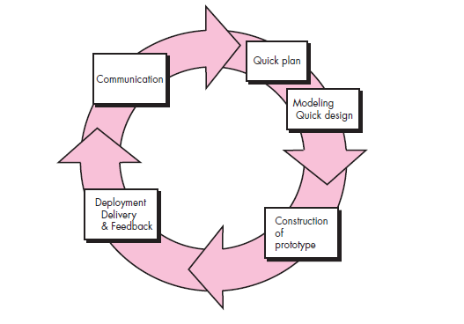
Evolutionary Process Models
Evolutionary models are iterative.
They are characterized in a manner that enables you to develop increasingly more complete versions of the software.
The Prototyping Model
The Spiral Model
The Concurrent Development Model
The Prototyping Model

Slide 58
The Prototyping Model
The basic idea in Prototype model is that instead of freezing the requirements before a design or coding can proceed, a throwaway prototype is built to understand the requirements.
This prototype is developed based on the currently known requirements. Prototype model is a software development model.
By using this prototype, the client can get an “actual feel” of the system, since the interactions with prototype can enable the client to better understand the requirements of the desired system.
Prototyping is an attractive idea for complicated and large systems for which there is no manual process or existing system to help determining the requirements.
The prototype are usually not complete systems and many of the details are not built in the prototype. The goal is to provide a system with overall functionality.

Slide 59
The Prototyping Model
Often, a customer defines a set of general objectives for software, but does not identify detailed requirements for functions and features.
In other cases, the developer may be unsure of the efficiency of an algorithm, the adaptability of an operating system, or the form that human-machine interaction should take.
In these, and many other situations, a prototyping paradigm may offer the best approach.
Although prototyping can be used as a stand-alone process model, it is more commonly used as a technique that can be implemented within the context of any one of the process models.
Regardless of the manner in which it is applied, the prototyping paradigm assists the software engineer and other customer to better understand what is to be built when requirements are fuzzy(unclear,puzzling).
The prototyping model begins with communication.
The software engineer and customer meet and define the overall objectives for the software, identify whatever requirements are known, and outline areas where further definition is mandatory.

Slide 60
The Prototyping Model
A prototyping iteration is planned quickly, and modeling (in the form of a “quick design”) occurs.
A quick design focuses on a representation of those aspects of the software that will be visible to end users (e.g., human interface layout or output display formats).
The quick design leads to the construction of a prototype.
The prototype is deployed and evaluated by the customer/user who provide feedback that is used to further refine requirements.
Iteration occurs as the prototype is tuned to satisfy the needs of the customer, while at the same time enabling you to better understand what needs to be done.
The prototype serves as a mechanism for identifying software requirements.
If a working prototype is built, the developer attempts to make use of existing program fragments or applies tools (e.g., report generators and window managers) that enable working programs to be generated quickly.

Slide 61
The Prototyping Model
Both customers and developers like the prototyping paradigm.
Users get a feel for the actual system, and developers get to build something immediately. Yet, prototyping can be problematic for the following reasons:
Customers see what appears to be a working version of the software,
Unaware that the prototype is held together haphazardly(accidently, randomly)
Unaware that in the rush to get it working you haven’t considered overall software quality or long-term maintainability.
When informed that the product must be rebuilt so that high levels of quality can be maintained, stakeholders cry foul(protest strongly)and demand that “a few fixes” be applied to make the prototype a working product.
Too often, software development management relents(quits).

Slide 62
The Prototyping Model
The developer often makes implementation compromises
In order to get a prototype working quickly.
An inappropriate operating system or programming language may be used simply because it is available and known;
An inefficient algorithm may be implemented simply to demonstrate capability.
After a time, developer may become comfortable with these choices and forget all the reasons why they were inappropriate.
The less-than-ideal choice has now become an integral part of the system.

Slide 63
The Prototyping Model
Follows an evolutionary and iterative approach
Used when requirements are not well understood
Serves as a mechanism for identifying software requirements
Focuses on those aspects of the software that are visible to the customer/user
Feedback is used to refine the prototype

Slide 64
Software Prototyping Application
Software Prototyping is most useful in development of systems having high level of user interactions such as online systems.
Systems which need users to fill out forms or go through various screens before data is processed can use prototyping very effectively to give the exact look and feel even before the actual software is developed.
Software that involves too much of data processing and most of the functionality is internal with very little user interface does not usually benefit from prototyping.

Slide 65
The Prototyping Model
Advantages | Disadvantages
Increased user involvement in the product even before implementation Since a working model of the system is displayed, the users get a better understanding of the system being developed. Reduces time and cost as the defects can be detected much earlier. Quicker user feedback is available leading to better solutions. Missing functionality can be identified easily Confusing or difficult functions can be identified | Risk of insufficient requirement analysis owing to too much dependency on prototype Users may get confused in the prototypes and actual systems. Practically, this methodology may increase the complexity of the system as scope of the system may expand beyond original plans. Developers may try to reuse the existing prototypes to build the actual system, even when its not technically feasible The effort invested in building prototypes may be too much if not monitored properly

Slide 66
The Spiral Model
Originally proposed by Barry Boehm [Boe88].
The spiral model is an evolutionary software process model that couples the iterative nature of prototyping with the controlled and systematic aspects of the waterfall model.
It provides the potential for rapid development of increasingly more complete versions of the software.
Boehm [Boe01a] describes the model in the following manner:
The spiral development model is a risk-driven process model generator that is used to guide multi-stakeholder concurrent engineering of software intensive systems.
It has two main distinguishing features.
One is a cyclic approach for incrementally growing a system’s degree of definition and implementation while decreasing its degree of risk.
The other is a set of anchor point milestones for ensuring stakeholder commitment to feasible and mutually satisfactory system solutions.

Slide 67
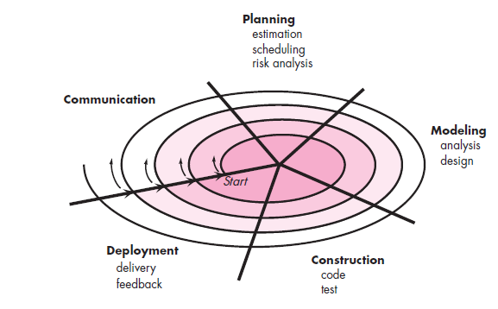
The Spiral Model

Slide 68
The Spiral Model
Using the spiral model, software is developed in a series of evolutionary releases.
During early iterations, the release might be a model or prototype. During later iterations, increasingly more complete versions of the engineered system are produced.
A spiral model is divided into a set of framework activities defined by the software engineering team.
For illustrative purposes, we use the generic framework activities discussed earlier. Each of the framework activities represent one segment of the spiral path illustrated in Figure 3.5.
As this evolutionary process begins, the software team performs activities that are implied by a circuit around the spiral in a clockwise direction, beginning at the center.
Risk is considered as each revolution is made.
Anchor point milestones—a combination of work products and conditions that are attained along the path of the spiral—are noted for each evolutionary pass.

Slide 69
The Spiral Model
The first circuit around the spiral might result in the development of a product specification;
subsequent passes around the spiral might be used to develop a prototype and then progressively more sophisticated versions of the software.
Each pass through the planning region results in adjustments to the project plan.
Cost and schedule are adjusted based on feedback derived from the customer after delivery.
In addition, the project manager adjusts the planned number of iterations required to complete the software.
Other process models end when software is delivered, the spiral model can be adapted to apply throughout the life of the computer software.
Therefore, the first circuit around the spiral might represent a “concept development project” that starts at the core of the spiral and continues for multiple iterations until concept development is complete.

Slide 70
The Spiral Model
If the concept is to be developed into an actual product, the process proceeds outward on the spiral and a “new product development project” commences.
The new product will evolve through a number of iterations around the spiral.
Later, a circuit around the spiral might be used to represent a “product enhancement project.”
In essence, the spiral, when characterized in this way, remains operative until the software is retired.
There are times when the process is dormant, but whenever a change is initiated, the process starts at the appropriate entry point (e.g., product enhancement).
The spiral model is a realistic approach to the development of large-scale systems and software.
Because software evolves as the process progresses, the developer and customer better understand and react to risks at each evolutionary level.

Slide 71
The Spiral Model
The spiral model uses prototyping as a risk reduction mechanism but, more important, enables the developer to apply the prototyping approach at any stage in the evolution of the product.
It maintains the systematic stepwise approach suggested by the classic life cycle but incorporates it into an iterative framework that more realistically reflects the real world.
The spiral model demands a direct consideration of technical risks at all stages of the project and, if properly applied, should reduce risks before they become problematic.
But like other models, the spiral model is not a panacea(remedy).
It may be difficult to convince customers (particularly in contract situations) that the evolutionary approach is controllable.
It demands considerable risk assessment expertise and relies on this expertise for success. If a major risk is not uncovered and managed, problems will undoubtedly occur.

Slide 72
The Spiral Model
Advantages
High amount of risk analysis hence, avoidance of Risk is enhanced.
Good for large and mission-critical projects.
Strong approval and documentation control.
Additional Functionality can be added at a later date.
Software is produced early in the software life cycle.
Disadvantages
Can be a costly model to use.
Risk analysis requires highly specific expertise.
Project’s success is highly dependent on the risk analysis phase.
Doesn’t work well for smaller projects.
When to use Spiral model
When costs and risk evaluation is important
For medium to high-risk projects
Long-term project commitment unwise because of potential changes to economic priorities
Users are unsure of their needs
Requirements are complex
New product line
Significant changes are expected

Slide 73
The Spiral Model
Advantages | Disadvantages
Changing requirements can be accommodated. Allows for extensive use of prototypes Requirements can be captured more accurately. Users see the system early. Development can be divided into smaller parts and more risky parts can be developed earlier which helps better risk management. | Management is more complex. End of project may not be known early. Not suitable for small or low risk projects and could be expensive for small projects. Process is complex Spiral may go indefinitely. Large number of intermediate stages requires excessive documentation.

Slide 74
The Concurrent Development Model
The concurrent development model, sometimes called concurrent engineering, can be represented schematically as a series of framework activities software engineering actions and tasks and their associated states.
For example, the modeling activity defined for the spiral model is accomplished by invoking one or more of the following software engineering actions: prototyping, analysis, and design.
Figure provides a schematic representation of one software engineering task within the modeling activity using a concurrent modeling approach.
The activity—modeling—may be in any one of the states noted at any given time. Similarly, other activities, actions, or tasks (e.g., communication or construction) can be represented in an analogous manner.
For example, early in a project the communication activity has completed its first iteration and exists in the awaiting changes state.
The modeling activity (which existed in the none state while initial communication was completed), now makes a transition into the under development state.

Slide 75
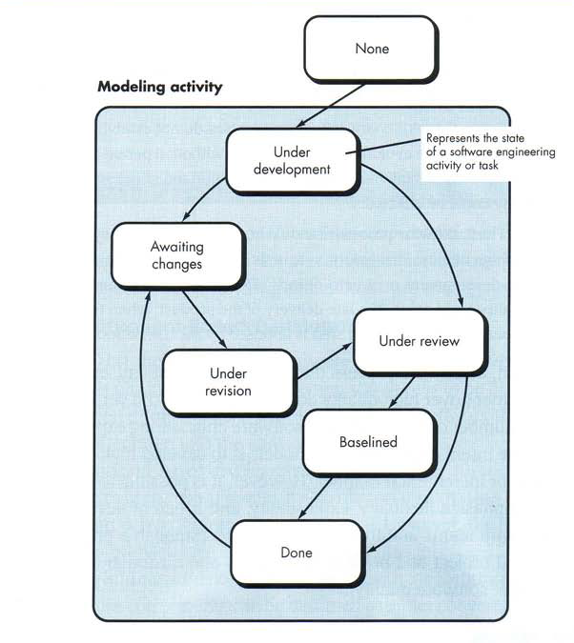
The Concurrent Development Model
All software engineering activities exist concurrently but reside in different states.

Slide 76
The Concurrent Development Model
If, however, the customer indicates that changes in requirements must be made, the modeling activity moves from the under development state into the awaiting changes state.
The Concurrent process model defines a series of events that will trigger transitions from state to state for each of the software engineering activities, actions, or tasks.
For example, during early stages of design (a major software engineering action that occurs during the modeling activity), an inconsistency in the requirements model is uncovered.
This generates the event analysis model correction, which will trigger the requirements analysis action from the done state into the awaiting changes state.
The Concurrent process model is applicable to all types of software development and provides an accurate picture of the current state of a project.
Rather than confining software engineering activities, actions, and tasks to a sequence of events, it defines a process network.
Each activity, action, or task on the network exists simultaneously with other activities, actions, or tasks. Events generated at one point in the process network trigger transitions among the states.

Slide 77
The Concurrent Development Model
Advantages of the concurrent development model
This model is applicable to all types of software development processes.
It is easy for understanding and use.
It gives immediate feedback from testing.
It provides an accurate picture of the current state of a project.
Disadvantages of the concurrent development model
It needs better communication between the team members.
This may not be achieved all the time.
It requires to remember the status of the different activities.

Slide 78
Software Measures, Metrics and Indicators
Within the software engineering context, a measure provides a quantitative indication of the extent, amount, dimension, capacity, or size of some attribute of a product or process.
Measurement is an act of determining a Measure.
IEEE definition of Metric: A quantitative measure of the degree to which a system, component or a process possesses a given attribute.
Indicator: It is a metric or combination of metrics that provides insight into a software process ,project or product.
An indicator provides insight that enables the project manager or software engineers to adjust the process, the project, or the process to make things better.
In short, a software engineer collects measures and develops metrics so that indicators will be obtained.

Slide 79
Measurement Principles
Measurement process is characterized by five activities:
Formulation. The derivation of software measures and metrics appropriate for the representation of the software that is being considered.
• Collection. The mechanism used to accumulate data required to derive the formulated metrics.
• Analysis. The computation of metrics and the application of mathematical tools.
• Interpretation. The evaluation of metrics resulting in insight into the quality of the representation.
• Feedback. Recommendations derived from the interpretation of product metrics transmitted to the software team.

Slide 80
Measurement Principles
• Principles for characterization and validation of metrics:
A metric should have desirable mathematical properties. That is, the metric’s value should be in a meaningful range (e.g., 0 to 1, where 0 truly means absence, 1 indicates the maximum value, and 0.5 represents the “halfway point”).
• When a metric represents a software characteristic that increases when positive traits occur or decreases when undesirable traits are encountered, the value of the metric should increase or decrease in the same manner.
• Each metric should be validated empirically (temporarily/ provisionally) in a wide variety of contexts before being published or used to make decisions. A metric should measure the factor of interest, independently of other factors. It should “scale up” to large systems and work in a variety of programming languages and system domains.

Slide 81
Process, Project And Measurement
Process Metrics:-
Are collected across all projects and over long periods of time. Their intent is to provide a set of process indicator that lead to long term software process improvement.
Project Metrics:-
enables a software project manager to
Assess the status of an ongoing project
Track potential risks.
Uncover problem areas before they go “Critical”
Adjust work flow or tasks
Evaluate the project team’s ability to control quality of software work products.
Measurement :-
Are collected by a project team and converted into process metrics during software process improvement.

Slide 82
Process Metrics and Software Process Improvement

Slide 83
Process Metrics and Software Process Improvement
Process at the center connecting 3 factors that have a profound influence on software quality and organizational performance.
Process triangle exists within a circle of environmental conditions that include the development environment, business conditions and customer characteristics.
We measure the efficacy of a software process indirectly.
That is, we derive a set of metrics based on the outcomes that can be derived from the process.
Outcomes include
measures of errors uncovered before release of the software
defects delivered to and reported by end-users
work products delivered (productivity)
human effort expended(consumed)
calendar time expended
schedule conformance
other measures.

Slide 84
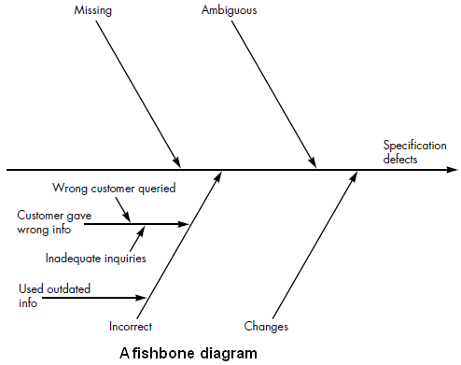
We also derive process metrics by measuring the characteristics of specific software engineering tasks.

Slide 85
Process Metrics Guidelines
Use common sense and organizational sensitivity when interpreting metrics data.
Provide regular feedback to the individuals and teams who collect measures and metrics.
Don’t use metrics to appraise(evaluate) individuals.
Work with practitioners and teams to set clear goals and metrics that will be used to achieve them.
Never use metrics to threaten individuals or teams.
Metrics data that indicate a problem area should not be considered “negative.” These data are merely an indicator for process improvement.
Don’t obsess(apply) on a single metric to the exclusion of other important metrics.

Slide 86
Project Metrics
Used to minimize the development schedule by making the adjustments necessary to avoid delays and mitigate potential problems and risks.
Used to assess product quality on an ongoing basis and, when necessary, modify the technical approach to improve quality.
Every project should measure:
Inputs—measures of the resources (e.g., people, tools) required to do the work.
Outputs—measures of the deliverables or work products created during the software engineering process.
Results—measures that indicate the effectiveness of the deliverables.

Slide 87
Project Metrics
Software process metrics are used for strategic purposes.
Software project metrics are tactical(well planned/ diplomatic) in nature.
That is, project metrics and the indicators derived from them are used by a project manager and a software team to adapt project work flow and technical activities.
The first application of project metrics on most software projects occurs during estimation.
Metrics collected from past projects are used as a basis from which effort and time estimates are made for current software work.
As a project proceeds, measures of effort and calendar time expended are compared to original estimates (and the project schedule). The project manager uses these data to monitor and control progress.

Slide 88
Project Metrics
As technical work commences, other project metrics begin to have significance. Production rates represented in terms of pages of documentation, review hours, function points, and delivered source lines are measured.
In addition, errors uncovered during each software engineering task are tracked.
As the software evolves from specification into design, technical metrics are collected to assess design quality and to provide indicators that will influence the approach taken to code generation and testing.
As quality improves, defects are minimized, and as the defect count goes down, the amount of rework required during the project is also reduced. This leads to a reduction in overall project cost.

Slide 89
Types of Software Measurements
Direct measures
– Easy to collect
– E.g. Cost, Effort, Lines of codes (LOC), Execution
Speed, Memory size, Defects etc.
Indirect measures
– More difficult to assess & can be measured
indirectly only.
– Quality, Functionality, Complexity, Reliability,
Efficiency, Maintainability etc.

Slide 90
Software Measurement
Individuals on two different project teams record and categorize all errors that they find during the software process.
Individual measures are then combined to develop team measures. Team A found 342 errors during the software process prior to release.
Team B found 184 errors. All other things being equal, which team is more effective in uncovering errors throughout the process? Because you do not know the size or complexity of the projects, you cannot answer this question.
However, if the measures are normalized, it is possible to create software metrics that enable comparison to broader organizational averages.

Slide 91
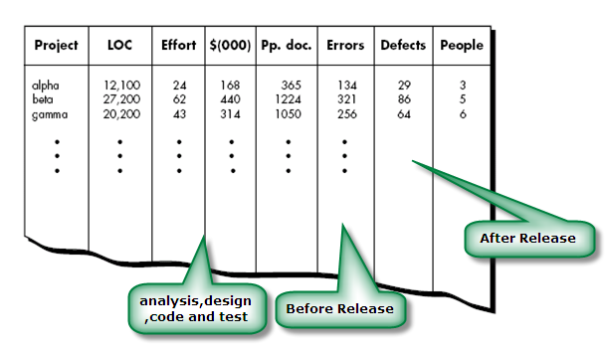
Size oriented metrics
Size-oriented software metrics are derived by normalizing quality and/or productivity measures by considering the size of the software that has been produced.
If a software organization maintains simple records, a table of size-oriented measures, such as the one shown in Figure can be created.
The table lists each software development project that has been completed over the past few years and corresponding measures for that project.
Referring to the table entry for project alpha:
12,100 lines of code were developed with 24 person-months of effort at a cost of $168,000.

Slide 92
Size oriented metrics
It should be noted that the effort and cost recorded in the table represent all software engineering activities (analysis, design, code, and test), not just coding.
Further information for project alpha indicates that 365 pages of documentation were developed, 134 errors were recorded before the software was released, and 29 defects were encountered after release to the customer within the first year of operation. Three people worked on the development of software for project alpha.

Slide 93
Size-Oriented metrics
In order to develop metrics that can be assimilated with similar metrics from other projects, you can choose lines of code as a normalization value. From the above data, simple size oriented metrics can be developed for each Project
• Errors per KLOC (thousand lines of code)
• Defects per KLOC
• $ per KLOC
• Pages of documentation per KLOC
• Errors per person-month
• KLOC per person-month
• $ per page of documentation
Advantages of Size Oriented Metrics
– LOC can be easily counted
– Many software estimation models use LOC or KLOC as input.
• Disadvantages of Size Oriented Metrics
– LOC measures are language dependent, programmer dependent
– Their use in estimation requires a lot of detail which can be difficult to achieve.
• Useful for projects with similar environment

Slide 94
Function-Oriented Metrics
Function-oriented software metrics use a measure of functionality delivered by the application as a normalization value.
Function Point (FP) is widely used as function oriented metrics.
Computation of the function point is based on characteristics of the software’s information domain and complexity.
The function point, like the LOC measure, is controversial.
FP is programming language independent.
Ideal for applications using conventional and nonprocedural languages.

Slide 95
Reconciling LOC and FP metric
Relationship between lines of code and function points depends upon the programming language that is used to implement the software and the quality of the design.
Following table provides rough estimates of the average number of LOC required to build one FP in various programming languages:

Slide 96
Metrics for software quality
The goal of software engineering is to produce a high-quality system, application, or product within a time frame that satisfies a market need.
The quality of a system, application, or product is only as good as the requirements that describe the problem, the design that models the solution, the code that leads to an executable program, and the tests that exercise the software to uncover errors.
You can use measurement to assess the quality of the requirements and design models, the source code, and the test cases that have been created as the software is engineered.

Slide 97
Metrics for software quality
A project manager must also evaluate quality as the project progresses.
Private metrics collected by individual software engineers are combined to provide project level results.
Private metrics include defect rates by individual , defect rates by software components and errors found during development.
Although many quality measures can be collected, the primary thrust at the project level is to measure errors and defects.
Metrics derived from these measures provide an indication of the effectiveness of individual and group software quality assurance and control activities.

Slide 98
Metrics for software quality
Metrics such as
work product errors per function point,
errors uncovered per review hour, and
errors uncovered per testing hour
provide insight into the efficacy(the ability to produce a desired or intended result) of each of the activities implied by the metric.
Error data can also be used to compute the defect removal efficiency (DRE) for each process framework activity.
Measuring Quality
Although there are many measures of software quality, correctness, maintainability, integrity, and usability provide useful indicators for the project team.
Correctness
Maintainability
Integrity
Usability
Defect Removal Efficiency method

Slide 99
Correctness
A program must operate correctly or it provides little value to its users.
Correctness is the degree to which the software performs its required function.
The most common measure for correctness is defects per KLOC, where a defect is defined as a verified lack of conformance to requirements.
When considering the overall quality of a software product, defects are those problems reported by a user of the program after the program has been released for general use.
For quality assessment purposes, defects are counted over a standard period of time, typically one year.

Slide 100
Maintainability
Maintenance required more effort than any other software engineering activity.
Maintainability is the ease with which a program can be corrected if an error is encountered, adapted if its environment changes, or enhanced if the customer desires a change in requirements.
There is no way to measure maintainability directly; therefore, we must use indirect measures.
A simple time-oriented metric is mean-time-to-change (MTTC), the time it takes to analyze the change request, design an appropriate modification, implement the change, test it, and distribute the change to all users.

Slide 101
Integrity
Software integrity has become increasingly important in the age of hackers and cyber terrorists.
This attribute measures a system's ability to withstand attacks (both accidental and intentional) to its security.
Attacks can be made on all three components of software:
Programs
Data
Documents
To measure integrity, two additional attributes must be defined:
Threat
Security

Slide 102
Integrity
Threat is the probability (which can be estimated or derived from practical evidence) that an attack of a specific type will occur within a given time.
Security is the probability (which can be estimated or derived from practical evidence) that the attack of a specific type will be prevented.
Integrity of a system can then be defined as
integrity = summation [(1 – (threat X (1 – security))]
where threat and security are summed over each type of attack.

Slide 103
Usability
The phrase "user-friendliness" has become everywhere in discussions of software products.
If a program is not user-friendly, it is often doomed to failure, even if the functions that it performs are valuable.
Usability is an attempt to quantify user-friendliness and can be measured in terms of four characteristics:
the physical and or intellectual skill required to learn the system,
the time required to become moderately efficient in the use of the system
productivity measured when the system is used by someone who is moderately efficient
A subjective assessment (sometimes through a questionnaire) of users attitudes toward the system.

Slide 104
Defect Removal Efficiency
A quality metric that provides benefit at both the project and process level is defect removal efficiency (DRE).
DRE is a measure of the filtering ability of quality assurance and control activities as they are applied throughout all process framework activities.
To compute DRE:
DRE = E / (E + D)
Where E= no. of error before release and D = defect found after release of software to end users
The ideal value for DRE is 1. That is, no defects are found in the software.
Realistically, D will be greater than 0, but the value of DRE can still approach 1. As E increases (for a given value of D), the overall value of DRE begins to approach 1.
In fact, as E increases, it is likely that the final value of D will decrease (errors are filtered out before they become defects).
DRE encourages a software project team to institute techniques for finding as many errors as possible before delivery.

Slide 105
Contd.
DRE can also be used within the project to assess a team’s ability to find errors before they are passed to the next framework activity or software engineering task.
For example, the requirements analysis task produces an analysis model that can be reviewed to find and correct errors. Those errors that are not found during the review of the analysis model are passed on to the design task.
When used in this context, we redefine DRE as
DREi = Ei/(Ei + Ei+1)
Ei is the number of errors found during software engineering activity i. Ei+1 number of errors found during software engineering activity i+1
A quality objective for a software team is to achieve DREi that approaches 1. That is, errors should be filtered out before they are passed on to the next activity.

Slide 106
Software Project Scheduling
Introduction
Project scheduling
Task network
Timeline chart
Earned value analysis

Slide 107
Why Projects Fail?
Changing customer requirement
Ambiguous/Incomplete requirement
Unrealistic deadline
An honest underestimation of effort
Predictable and/or unpredictable risks
Technical difficulties
Miscommunication among project staff

Slide 108
Why Software is delivered late? Eight Reasons for Late Software Delivery
An unrealistic deadline established by someone outside the software engineering group and forced on managers and practitioners within the group.
Changing customer requirements that are not reflected in schedule changes.
An honest underestimate of the amount of effort and /or the number of resources that will be required to do the job.
Predictable and/or unpredictable risks that were not considered when the project commenced.
Technical difficulties that could not have been foreseen in advance.
Human difficulties that could not have been foreseen in advance.
Miscommunication among project staff that results in delays.
A failure by project management to recognize that the project is falling behind schedule and a lack of action to correct the problem.

Slide 109
Handling Unrealistic Deadlines
Perform a detailed estimate using historical data from past projects; determine the estimated effort and duration for the project.
Using an incremental model, develop a software engineering strategy that will deliver critical functionality by the imposed deadline, but delay other functionality until later; document the plan.
Meet with the customer and (using the detailed estimate) explain why the imposed deadline is unrealistic.
Be certain to note that all estimates are based on performance on past projects.
Also be certain to indicate the percent improvement that would be required to achieve the deadline as it currently exists.
Offer the incremental development strategy as an alternative and offer some options:
Increase the budget and bring on additional resources to try to finish sooner.
Remove many of the software functions and capabilities that were requested.
Dispense with reality and wish the project complete using the prescribed schedule; then point out that project history and your estimates show that this is unrealistic and will result in a disaster.

Slide 110
General Practices (continued)‏
Software project scheduling
It is an activity that distributes estimated effort across the planned project duration by allocating the effort to specific tasks.
During early stages of project planning, a macroscopic schedule is developed identifying all major process framework activities and the product functions to which they apply.
Later, each task is refined into a detailed schedule where specific software tasks are identified and scheduled.

Slide 111
Basic Principles for Project Scheduling
Compartmentalization
The project must be compartmentalized(distributed) into a number of manageable activities, actions, and tasks;
both the product and the process are decomposed.
Interdependency
The interdependency of each compartmentalized activity, action, or task must be determined.
Some tasks must occur in sequence while others can occur in parallel.
Some actions or activities cannot commence until the work product produced by another is available.

Slide 112
Basic Principles for Project Scheduling (continued)‏
Time allocation
Each task to be scheduled must be allocated some number of work units.
In addition, each task must be assigned a start date and a completion date that are a function of the interdependencies.
Start and stop dates are also established based on whether work will be conducted on a full-time or part-time basis.
Effort validation
Every project has a defined number of people on the team.
As time allocation occurs, the project manager must ensure that no more than the allocated number of people have been scheduled at any given time.

Slide 113
Basic Principles for Project Scheduling (continued)‏
Defined responsibilities
Every task that is scheduled should be assigned to a specific team member.
Defined outcomes
Every task that is scheduled should have a defined outcome for software projects such as a work product or part of a work product.
Work products are often combined in deliverables.
Defined milestones
Every task or group of tasks should be associated with a project milestone.
A milestone is accomplished when one or more work products has been reviewed for quality and has been approved.

Slide 114
40-20-40 Distribution of Effort
A recommended distribution of effort across the software process is 40% (analysis and design), 20% (coding), and 40% (testing)‏.
Work expended on project planning rarely accounts for more than 2 - 3% of the total effort.
Requirements analysis may comprise 10 - 25%.
Effort spent on prototyping and project complexity may increase this.
Software design normally needs 20 – 25%.
Coding should need only 15 - 20% based on the effort applied to software design.
Testing and subsequent debugging can account for 30 - 40%.
Safety or security-related software requires more time for testing.

Slide 115
40-20-40 Distribution of Effort (continued)‏
Example: 100-day project
Analysis
Design
Coding
Testing
40
20
40

Slide 116
Factors that Influence a Project’s Schedule
Size of the project
Number of potential users
Mission criticality
Application longevity(durability)
Stability of requirements
Ease of customer/developer communication
Maturity of applicable technology
Performance constraints
Embedded and non-embedded characteristics
Project staff
Reengineering factors

Slide 117
Task Network: Defining a Task Set
A task set is the work breakdown structure for the project.
No single task set is appropriate for all projects and process models
It varies depending on the project type and the degree of rigor (based on influential factors) with which the team plans to work.
The task set should provide enough discipline to achieve high software quality
But it must not burden the project team with unnecessary work.

Slide 118
Purpose of a Task Network
Also called an activity network.
It is a graphic representation of the task flow for a project.
It depicts task length, sequence, concurrency, and dependency.
Points out inter-task dependencies to help the manager ensure continuous progress toward project completion.
The critical path
A single path leading from start to finish in a task network.
It contains the sequence of tasks that must be completed on schedule if the project as a whole is to be completed on schedule.
It also determines the minimum duration of the project.

Slide 119
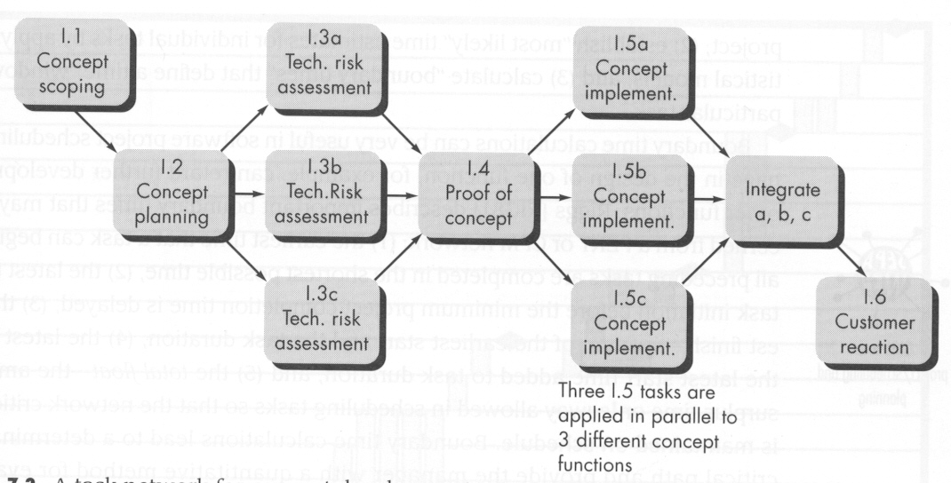
Example Task Network

Slide 120
Project Scheduling Methods
Program evaluation and review technique (PERT) and the critical path method (CPM) are two project scheduling methods that can be applied to software development.
Both techniques are driven by information already developed in earlier project planning activities:
estimates of effort,
a decomposition of the product function,
the selection of the appropriate process model and task set, and
decomposition of the tasks that are selected.
Interdependencies among tasks may be defined using a task network.
Tasks, sometimes called the project work breakdown structure (WBS), are defined for the product as a whole or for individual functions.

Slide 121
Mechanics of a Timeline Chart
Also called a Gantt chart; invented by Henry Gantt, industrial engineer, 1917.
All project tasks are listed in the far left column.
The next few columns may list the following for each task: projected start date, projected stop date, projected duration, actual start date, actual stop date, actual duration, task inter-dependencies (i.e., predecessors)‏.
To the far right are columns representing dates on a calendar.
The length of a horizontal bar on the calendar indicates the duration of the task.
When multiple bars occur at the same time interval on the calendar, this implies task concurrency.
A diamond in the calendar area of a specific task indicates that the task is a milestone; a milestone has a time duration of zero.

Slide 122
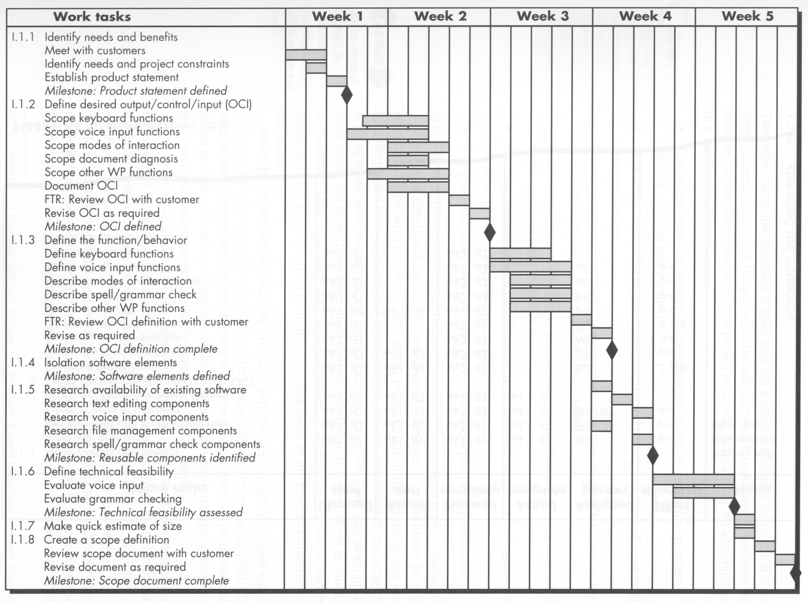

Slide 123
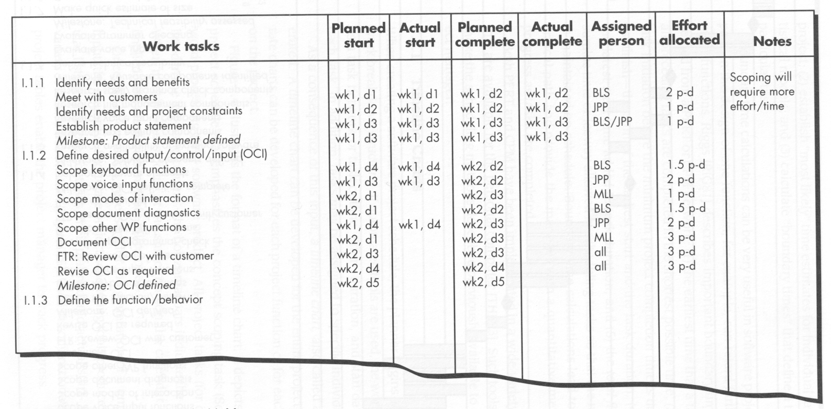
An Example Project Table

Slide 124
Methods for Tracking the Schedule
Qualitative approaches
Conduct periodic project status meetings in which each team member reports progress and problems.
Evaluate the results of all reviews conducted throughout the software engineering process.
Determine whether formal project milestones (i.e., diamonds) have been accomplished by the scheduled date.
Compare actual start date to planned start date for each project task listed in the timeline chart.
Meet informally with the software engineering team to obtain their subjective assessment of progress to date and problems on the horizon.
Quantitative approach
Use earned value analysis to assess progress quantitatively.

Slide 125
Earned Value Analysis
Earned value analysis is a measure of progress by assessing the percent of completeness for a project
It gives accurate and reliable readings of performance very early into a project
It provides a common value scale (i.e., time) for every project task, regardless of the type of work being performed
The total hours to do the whole project are estimated, and every task is given an earned value based on its estimated percentage of the total
The budgeted cost of work scheduled (BCWS)
is determined for each work task represented in the schedule.
During estimation, the work (in person-hours or person-days) of each software engineering task is planned.
Hence, BCWS_{i} is the effort planned for work task i.
To determine progress at a given point along the project schedule, the value of BCWS is the sum of the BCWS_{i} values for all work tasks that should have been completed by that point in time on the project schedule.

Slide 126
Earned Value Analysis
The BCWS values for all work tasks are summed
to derive the budget at completion (BAC).
Hence, BAC= Ʃ (BCWS_{k}) for all tasks k
Next, the value for budgeted cost of work performed (BCWP) is computed.
The value for BCWP is the sum of the BCWS values for all work tasks that have actually been completed by a point in time on the project schedule.
“The distinction between the BCWS and the BCWP is that the former represents the budget of the activities that were planned to be completed and the latter represents the budget of the activities that actually were completed.”

Slide 127




Earned Value Analysis
Given values for BCWS, BAC, and BCWP, important progress indicators
Schedule performance index, SPI
Schedule variance,
SPI is an indication of the efficiency with which the project is utilizing scheduled resources. An SPI value close to 1.0 indicates efficient execution of the project schedule. SV is simply an absolute indication of variance from the planned schedule.
Percent scheduled for completion
provides an indication of the percentage of work that should have been completed by time t.
Percent complete provides a quantitative indication of the percent of completeness of the project at a given point in time t.

Slide 128

Earned Value Analysis
It is also possible to compute the actual cost of work performed (ACWP). The value for ACWP is the sum of the effort actually expended on work tasks that have been completed by a point in time on the project schedule. It is then possible to compute
A CPI value close to 1.0 provides a strong indication that the project is within its defined budget. CV is an absolute indication of cost savings (against planned costs)or shortfall at a particular stage of a project.

